Slide 1
"Barangay Child Immunization Monitoring System: A Digital Solution for Enhanced Immunization Record Management in Philippine Communities"
Clinitrack
(AI)

Slide 2
Table of contents
01
02
03
04
Problem Discussion
What is Clinitrack?
UML
Functionalities

Slide 3
01
Problem Discussion
(CL)

Slide 4
The healthcare sector in Philippine barangays faces challenges in maintaining accurate immunization records for children due to the lack of a comprehensive digital health system. Digital solutions can improve health service delivery and timely vaccination tracking, benefiting children in underserved areas. Implementing a digital immunization record system at the barangay level can effectively manage and monitor child immunization data, leading to better child health outcomes.

Slide 5

02
What is Clinitrack?
(CL)

Slide 6
(CT) = Clinitrack is a system that simplifies child registration and records vaccine usage in barangays. It streamlines the registration process, maintains accurate vaccine records, and ensures timely immunizations. Improve healthcare management for children in your community with an efficient and secure system.

Slide 7
03
UML
(CL)

Slide 8
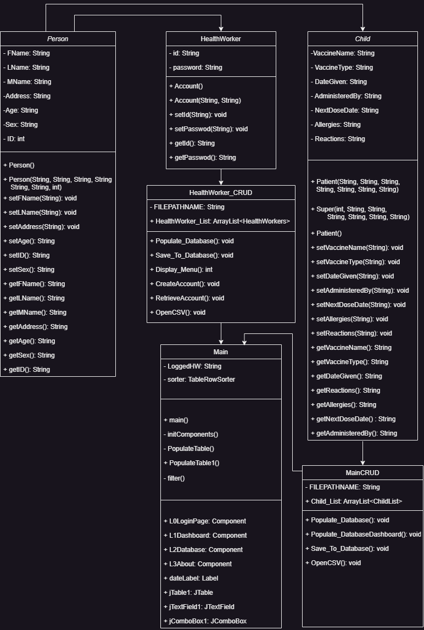
UML

Slide 11
04
Functionalities

Slide 12
Functionalities
(a) Registration
The system would include a registration feature where healthcare workers can enroll children into the digital immunization record system. This process would involve capturing essential demographic information, such as the child's name, and other details.
(b) Scheduling of Vaccine
The system would provide a scheduling feature to help healthcare workers and parents/guardians track and plan upcoming immunizations based on the child's age and recommended vaccination schedule.

Slide 13
(c) Data Storage and Retrieval:
The system would securely store immunization records, allowing authorized healthcare providers to access and retrieve the information when needed. This would facilitate continuity of care and accurate monitoring of vaccination statuses.

Slide 14
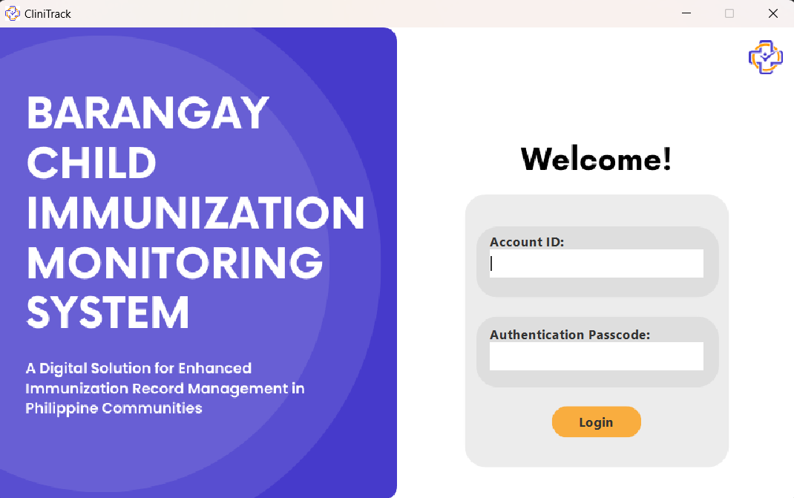
(d) Login
The digital immunization record system ensures that only authorized personnel with valid credentials can access the system, input data into the database, and retrieve information. These security measures safeguard the integrity and confidentiality of the immunization data, reducing the risk of unauthorized access or misuse.

Slide 15
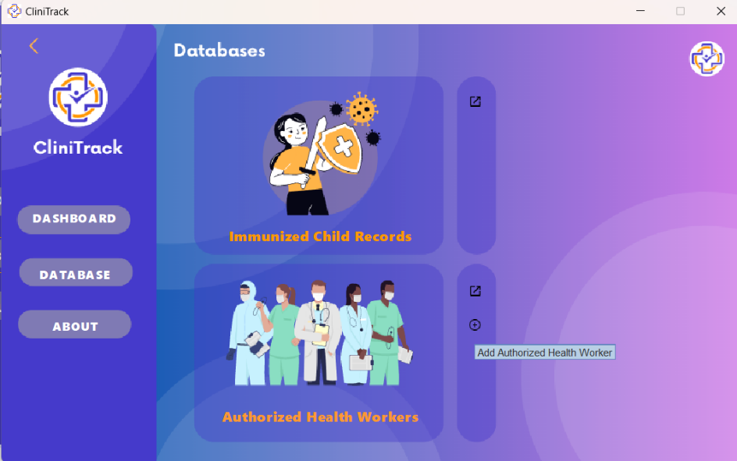
(e) Viewing of Database
The system allows the admin to view the information of the children and accounts in the database.

Slide 16
(f) Medical Details
The Clinitrack systems dashboard will show the medical details of the children including the name, type of vaccine, date given and the next dose date.
(f) Search Filter
The system search bar filter allows the user efficient browsing of data, by enabling them to search using by ID, Address, Age,Sex.

Slide 17
(g) Authorized HealthWorker
Only authorized personnel can access the data within the system.
(h) Notes
The system has “notes” informs the healthcare worker using the system about the allergies and reactions of the children after the vaccine is given. This feature ensures informed decisions and necessary precautions for the future vaccinations.

Slide 18
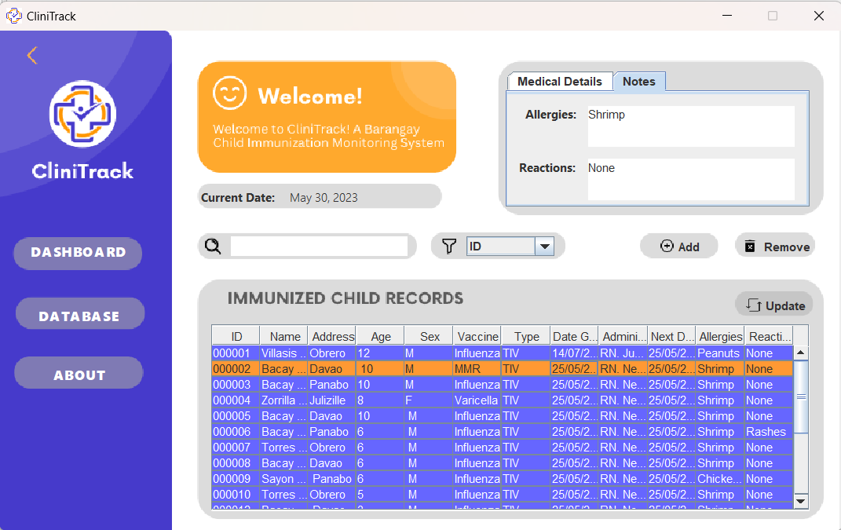
Medical Details
Notes
Search Filter
Viewing of Database

Slide 19
Clinitrack

